Slide 1
Intro to Databases
Fullstack Academy

Slide 2
Appreciating Databases
Ubiquitous: Almost every application you write will require a database
A Standard: Databases are the one constant across many stacks. Especially SQL databases.
Challenging: Databases are easy to use but often challenging to manage, scale and optimize.
Useful: Databases help us uncover interesting data
Powerful: Database Admins are
Feared by developers
…but also taken for granted until things break
Befriended by business people
Contacted by the government for secret data (e.g. NSA)
Notes:
What makes a programming language “fun?”
literacy, how easy it is to read
how well it matches our own thought processes
how easy it is to fix when we get things wrong
clear syntax
clear symantics
expressive
efficient

Slide 3
Database Management System
What is a Database?
Databases you know
Excel
Computer’s File Structure
Cell Phone Book
What else?
Making a database is as easy as collecting data
Hard part is managing, querying and analyzing data
How was this problem historically dealt with?

Slide 4
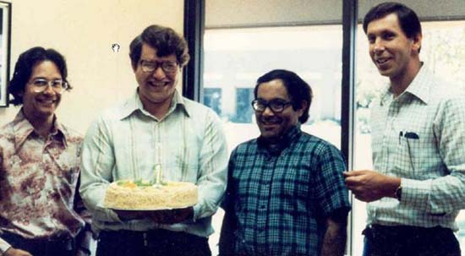
History of Databases
Ed Oates, Unknown, Bob Miner, Larry Ellison (1978)

Slide 5
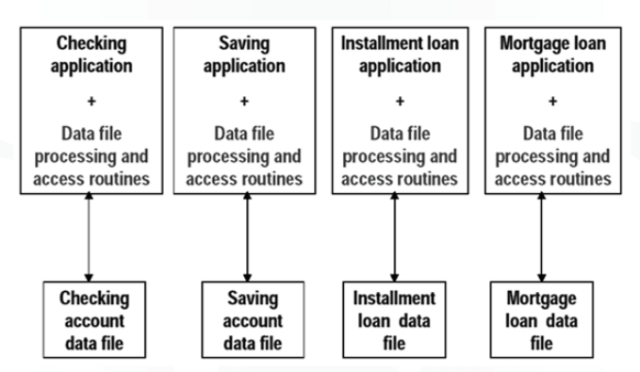
Before Relational Databases
Data storage before the 70s
Data stored in custom “data files”
Data queried using code written specifically for one application
Advantages
Middle layer not needed
Solutions customized for each application
Disadvantages
Hard to change the system
Knowledge not compounding
Data-transfer is difficult

Slide 6
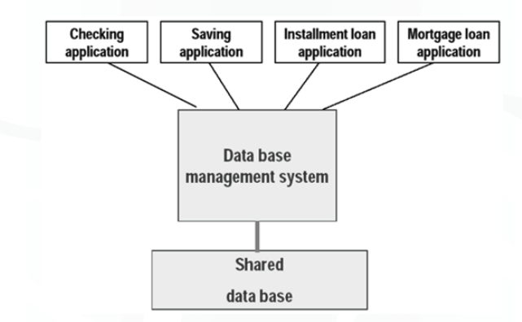
Relational Database Systems
Relational Databases popularized in the 80s to solve these problems (by Oracle & IBM)
One layer and language to store and access data
Sold early-on as a way for “non-technical people” to have access to precious data

Slide 7
Relational Database Management Systems (RDBMS)

Slide 8
About RDBMS
Data is stored in relations (tables)
A simple, structured query language: SQL
Programmers can specify what answers a query should return, but not how the query is executed or where and how the data is stored
DBMS picks the best execution strategy based on indexes, data, workload etc.
Multi-user, Multi-threaded
Multiple processes can access database at same time

Slide 9
Definitions in a Database
Database Definitions
DBs are a collection of Tables (or relations)
Tables have Columns (attributes) and Rows (instances or tuples)
Tables are just like Excel Sheets
Duplicate rows are not allowed

Slide 10
Schema and Content
Schema - how data is structured
Shouldn’t change very often (but does)
Example:
Tables Student, School, Enrollment
Instance
Actual Data (Rows)
Example: {1, “Bart S.”, 10, “M”}
Notes:
What makes a programming language “fun?”
literacy, how easy it is to read
how well it matches our own thought processes
how easy it is to fix when we get things wrong

Slide 11
SQL

Slide 12
SQL has stood the test of time
“Structured English Query Language”
Developed originally by IBM based on Dr. Edgar F. Codd’s paper on Relational Databases (1970)
In 1979, Oracle released first commercially available implementation of SQL.

Slide 13
SQL
SQL is used to Retrieve/Insert/Update data from a database
There are four major SQL commands (CRUD). They are pretty self-explanatory and easy to remember
INSERT: Insert new rows into a table
SELECT: The SELECT command is used to get data from a database
UPDATE: Update existing rows in a table
DELETE: Delete rows from a table
(bonus) CREATE: Make new tables/views/indexes
Notes:
What makes a programming language “fun?”
literacy, how easy it is to read
how well it matches our own thought processes
how easy it is to fix when we get things wrong

Slide 14
An Example DB
Student
School
ID | Name | Age | Gender
1 | Bart S. | 10 | M
2 | Lisa S. | 8 | F
3 | Jim F. | 13 | M
4 | Joan B. | 15 | F
ID | Name | Level
1 | Springfield Elementary | E
2 | Brook Middle | M
3 | Springbrook High | H
4 | Simpson Univ | U
Enrollment
StudentID | SchoolID
1 | 1
2 | 1
3 | 2
4 | 3

Slide 15
SQL By Example - SELECT
Let’s retrieve data from our Simpsons School DB
Student
ID | Name | Age | Gender
1 | Bart S. | 10 | M
2 | Lisa S. | 8 | F
3 | Jim F. | 13 | M
4 | Joan B. | 15 | F
SELECT *
FROM Student
WHERE age > 12
ID | Name | Age | Gender
3 | Jim F. | 13 | M
4 | Joan B. | 15 | F

Slide 16
A more interesting SELECT
Let’s say we want to find all students from Springfield Elementary
The student table doesn’t list the school.
We have to use the enrollment table. Will this take two steps?
School
Enrollment
Student
ID | Name | Level
1 | Springfield Elementary | E
2 | Brook Middle | M
3 | Springbrook High | H
4 | Simpson Univ | U
StudentID | SchoolID
1 | 1
2 | 1
3 | 2
4 | 3
ID | Name | Age | Gender
1 | Bart S. | 10 | M
2 | Lisa S. | 8 | F
3 | Jim F. | 13 | M
4 | Joan B. | 15 | F

Slide 17
SQL JOINS
In fact, we can find all the students from Springfield Elementary (ID: 1) in one SQL statement using a JOIN
A SQL JOIN is used to combine rows from two or more tables, based on a common field between them.
Can you visualize it?
School
Enrollment
Student
ID | Name | Level
1 | Springfield Elementary | E
2 | Brook Middle | M
3 | Springbrook High | H
4 | Simpson Univ | U
StudentID | SchoolID
1 | 1
2 | 1
3 | 2
4 | 3
ID | Name | Age | Gender
1 | Bart S. | 10 | M
2 | Lisa S. | 8 | F
3 | Jim F. | 13 | M
4 | Joan B. | 15 | F

Slide 18
SQL JOINS - II
If we joined the Student and School tables using the data in the Enrollment table, here is how it could look
Student ID | Name | Age | Gender | School ID | School Name | Level
1 | Bart S. | 10 | M | 1 | Springfield Elementary | E
2 | Lisa S. | 8 | F | 1 | Springfield Elementary | E
3 | Jim F. | 13 | M | 2 | Brook Middle | M
4 | Joan B. | 15 | F | 3 | Springbrook High | H
SQL Query
SELECT *
FROM
Student INNER JOIN Enrollment ON Student.id = Enrollment.StudentID
INNER JOIN School ON Enrollment.SchoolID = School.id
WHERE Enrollment.SchoolID = 1

Slide 19
Learning SQL
Much more to learn
What’s next?
Go over SQL on Treehouse
Practice by doing in workshop
Treehouse links are on workshop

Slide 20
More Practice
To get practice with SQL, let’s go back to the pre-term.
Two stages to re-do on Treehouse:
Reading Data from Databases with SQL
http://teamtreehouse.com/library/programming/database-foundations/reading-data-from-databases-with-sql
Joining Relational Data Between Tables in SQL
http://teamtreehouse.com/library/programming/database-foundations/joining-relational-data-between-tables-in-sql
Warnings:
Treehouse uses MySQL so some of the software may be different

Slide 21
Workshop
Lets do the workshop

